Slide 1


Macroeconomics
Ninth Edition
Chapter 9
Unemployment and Inflation
Copyright © 2025, 2021, & 2018 Pearson Education, Inc. All Rights Reserved
Notes:
If this PowerPoint presentation contains mathematical equations, you may need to check that your computer has the following installed:
1) MathType Plugin
2) Math Player (free versions available)
3) NVDA Reader (free versions available)

Slide 2
Chapter Outline
9.1 Measuring the Unemployment Rate, the Labor Force Participation Rate, and the Employment-Population Ratio
9.2 Types of Unemployment
9.3 Explaining Unemployment
9.4 Measuring Inflation
9.5 Using Price Indexes to Adjust for the Effects of Inflation
9.6 Nominal Interest Rates versus Real Interest Rates
9.7 Does Inflation Impose Costs on the Economy?

Slide 3
Want to Know How the U.S. Economy Is Doing? Check Out Georgetown, K Y
Scott County, K Y is home to the Georgetown Toyota plant, the largest Toyota factory in the world. Manufacturers of durable goods (like cars) are very sensitive to changes in the economy, as seen in the table below.
Time period | Unemployment rate
Just before 2007–2009 recession | 3.8%
July 2009 | 13.2%
2020 Covid-19 recession | 21.5%
Mid-2023 | 3.0%

Slide 4
Measuring Unemployment and Inflation
In Chapter 18, we learned how to measure total output—a critical first step in understanding the economy.
In this chapter, we continue along these lines by learning how to measure unemployment and inflation.
These are very important and commonly used macroeconomic concepts; we want to solidify our understanding of what they mean so that we can talk intelligently about them.

Slide 5
9.1 Measuring the Unemployment Rate, the Labor Force Participation Rate, and the Employment–Population Ratio
Define the unemployment rate, the labor force participation rate, and the employment–population ratio and understand how they are computed.
There around 330 million people in the United States, so monitoring and reporting on their activities regularly would be very difficult and costly, not to mention invasive.
Instead, the U.S. Department of Labor reports estimates of employment, unemployment, and other statistics related to the labor force each month.
Labor force: The sum of employed and unemployed workers in the economy.
Of these statistics, the most watched is known as the unemployment rate: The percentage of the labor force that is unemployed.

Slide 6
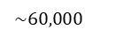
The Household Survey
Each month, the U.S. Census Bureau conducts the Current Population Survey (a.k.a. the household survey).
$$\sim 60,000$$
households selected to be “representative”
Household members of “working age” (16+ years old)
Asked about employment during “reference week”
Also asked about recent job search activities
People are then classified as:
Employed: In government statistics, someone who currently has a job or who is temporarily away from his or her job.
Unemployed: In government statistics, someone who is not currently at work but who is available for work and who has actively looked for work during the previous month.
Not in the labor force, if neither of the above apply

Slide 7
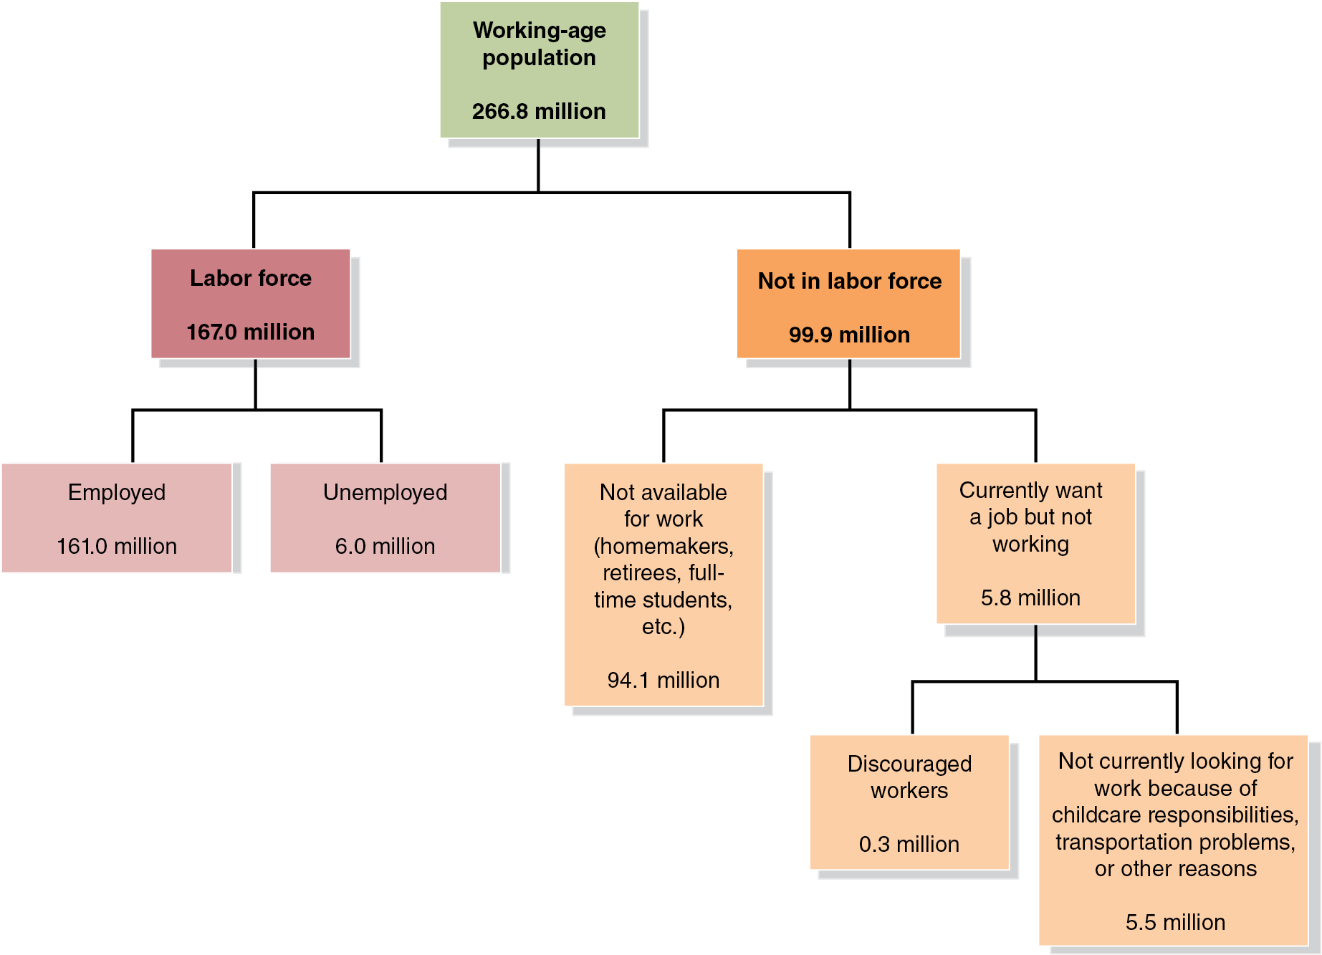
Figure 9.1 The Employment Status of the Civilian Working-Age Population, June 2023 (1 of 4)
Discouraged workers: People who are available for work but have not looked for a job during the previous four weeks because they believe no jobs are available for them.
Notes:
The flow diagram is as follows. Working age population, 266.8 million, branches into labor force, 167.0 million, and not in labor force, 99.9 million. Labor force branches into employed, 161.0 million, and unemployed, 6.0 million. Not in labor branches into not available for work, homemakers, retirees, full time students, et cetera, 94.1 million and currently want a job, but not working, 5.8 million. Currently want a job, but not working branches into discouraged workers, 0.3 million, and not currently looking for work because of childcare responsibilities, transportation problems, or other reasons, 5.5 million.

Slide 8
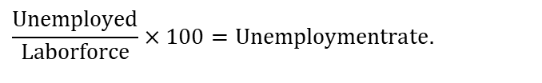
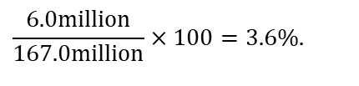
Figure 9.1 The Employment Status of the Civilian Working-Age Population, June 2023 (2 of 4)
Based on the B L S estimates, we calculate several important macroeconomic indicators.
The most watched is the unemployment rate:
$$\frac{Unemployed}{Laborforce}×100=Unemploymentrate.$$
$$\frac{6.0million}{167.0million}×100=3.6\%.$$
This most common measure of unemployment is known formally as B L S series U-3.

Slide 9
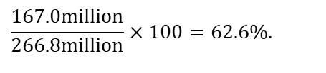
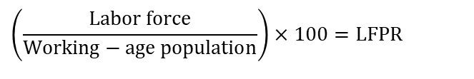
Figure 9.1 The Employment Status of the Civilian Working-Age Population, June 2023 (3 of 4)
Also important are the labor-force participation rate: The percentage of the working-age population in the labor force...
$$\left(\frac{Labor force}{Working−age population}\right)×100=LFPR$$
$$\frac{167.0million}{266.8million}×100=62.6\%.$$

Slide 10
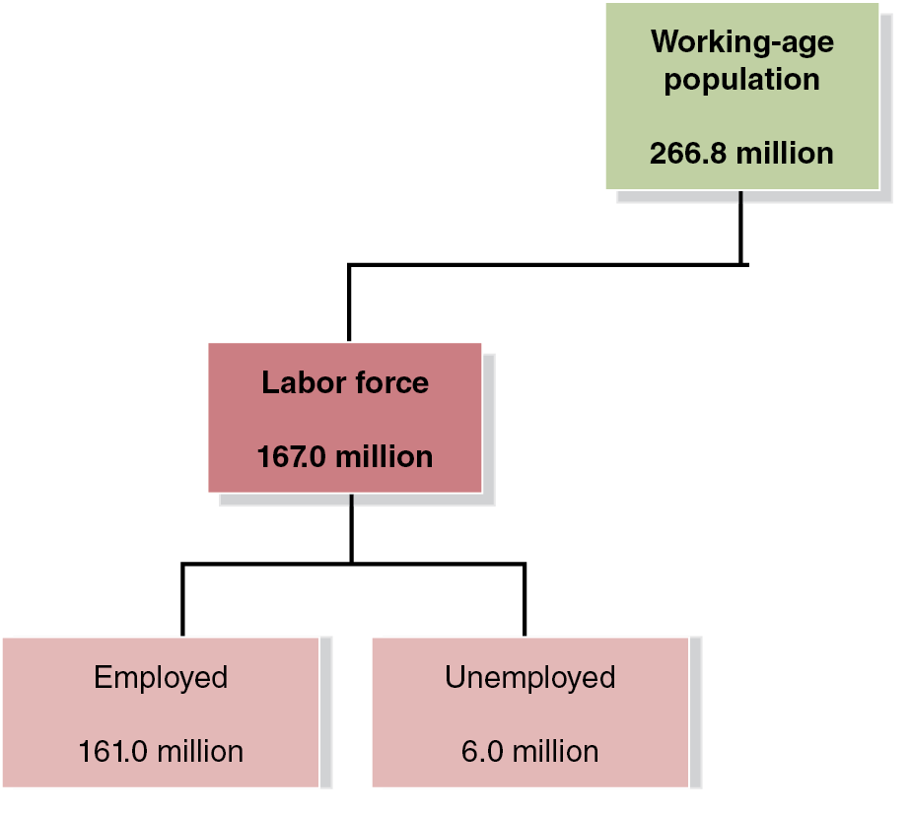
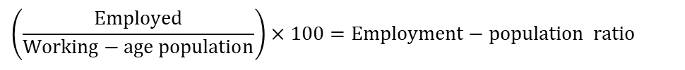
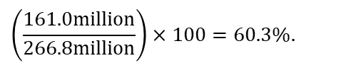
Figure 9.1 The Employment Status of the Civilian Working-Age Population, June 2023 (4 of 4)
… and the employment-population ratio: The percentage of the working-age population that is employed:
$$\left(\frac{Employed}{Working−age population}\right)×100=Employment−population ratio$$
$$\left(\frac{161.0million}{266.8million}\right)×100=60.3\%.$$

Slide 11
Problems with Measuring the Unemployment Rate
The unemployment rate measured by the B L S is not a perfect measure of joblessness. Why?
It may understate unemployment:
Distinguishing between people who are unemployed and not in the labor force requires judgment (should we exclude “discouraged workers?”)
Only measures employment, not intensity of employment (full-time versus. part-time; some people are underemployed)
It may overstate unemployment:
People might claim falsely to be actively looking for work
May claim not to be working to evade taxes or keep criminal activity unnoticed

Slide 12
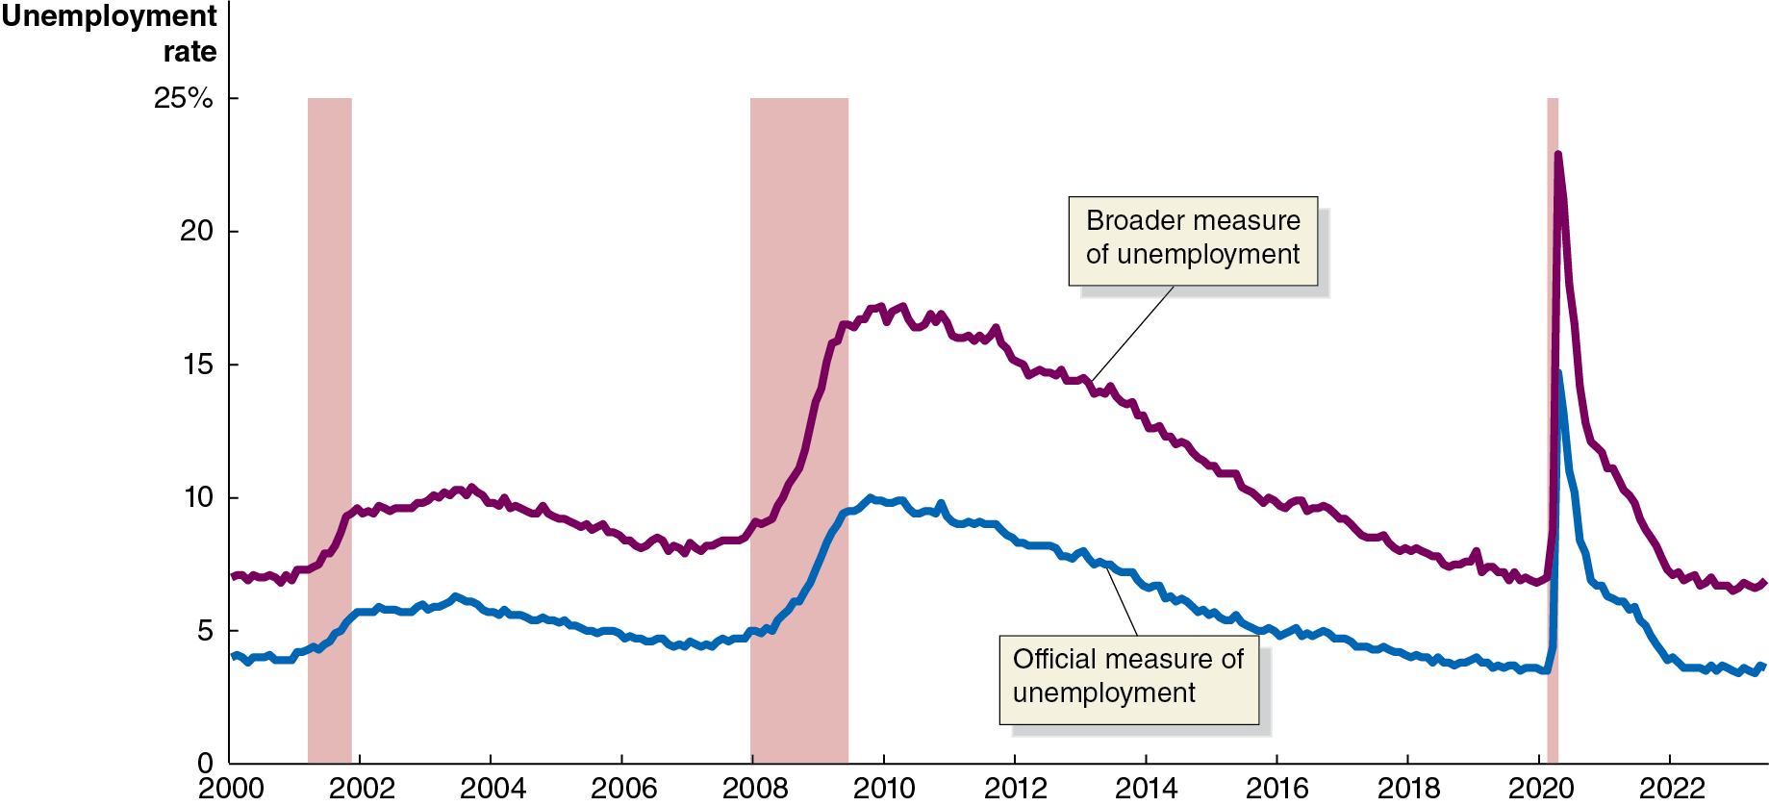
Figure 9.2 The Official Unemployment Rate and a Broad Measure of the Unemployment Rate, Jan 2000–June 2023
Some people suggest that we should include discouraged workers and underemployed workers in the unemployment statistics, to create a broader measure of unemployment.
The B L S measures this, calling it B L S series U-6.
Notes:
The horizontal axis represents year, and ranges from 2000 to 2022, in increments of 2 years. The vertical axis represents unemployment rate, and ranges from 0 to 25 percentage in increments of 5 percentages. The year 2001, the area between years 2007 to 2009, and year 2021 are shaded to indicate economic recession. The lines for official measure of unemployment, and broader measure of unemployment follow almost identical paths with small, tightly grouped rises and falls, with the broader measure of unemployment line higher on the graph. The official measure of unemployment curve, in blue, begins at 4% in 2000, rises through the first shaded area in 2001 to 6% in 2003, and gradually falls before the second shaded area in 2007 to 2009, and rises to 9% by the end of 2009, and falls steadily back to 4% in early 2020. The curve then peaks to 23% in mid 2020, then falls to 14% in later 2020, and ends at 7.5% in 2023. The broader measure of unemployment curve, in red, begins at 7% in 2000, rises through the first shaded area to 9.5% in 2003, and gradually falls before the second shaded area, and rises to 17% by the end of 2009, and falling steadily to 6% in early 2020. The curve then peaks to 15% in mid 2020, then falls to 7% in later 2020, and ends at 4% in 2023. All values are estimated.

Slide 13
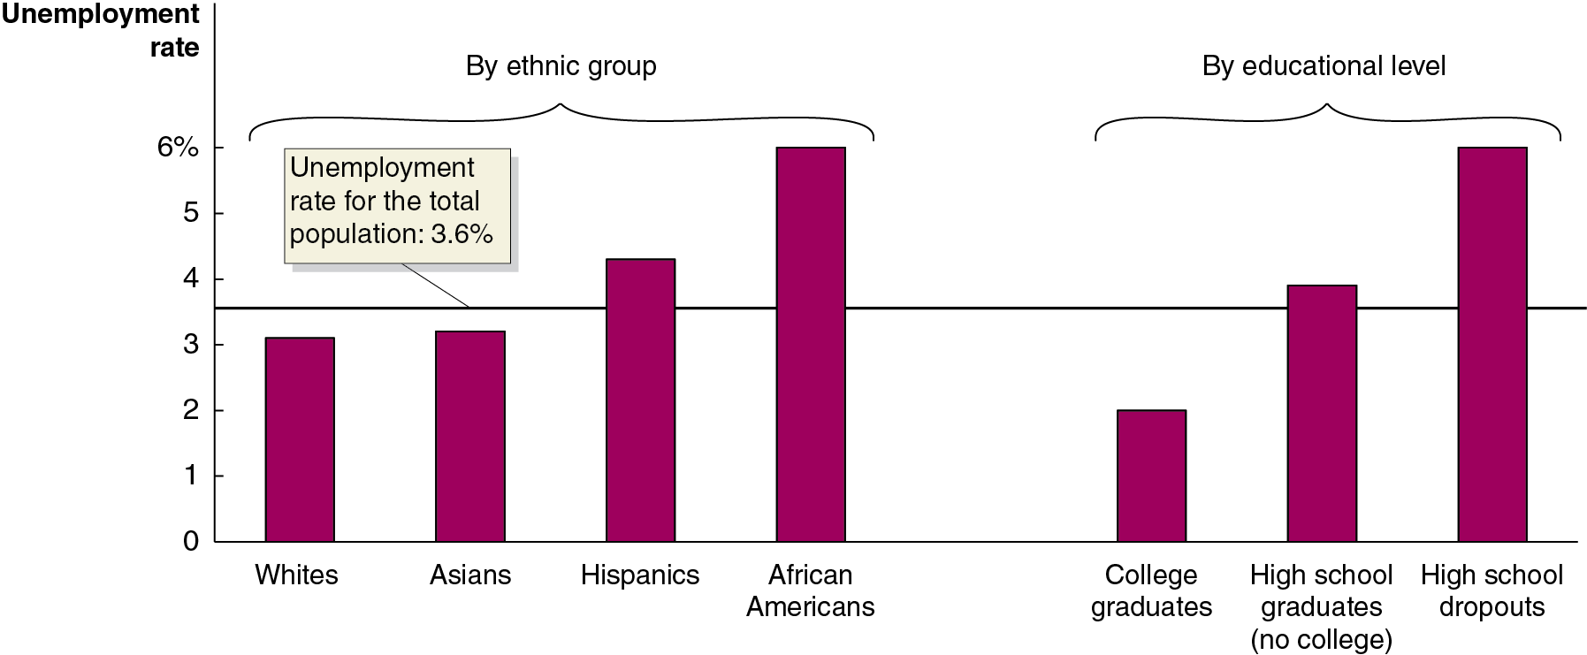
Figure 9.3 Unemployment Rates in the United States, June 2023
Unemployment rates vary by ethnic group…
… and by education level.
These two observations are statistically related.
Notes:
The horizontal axis represents ethnic group and educational level, and the vertical axis represents unemployment rate. The horizontal line for unemployment rate for the total population is set at 3.6%.
The data from the bar graph by ethnic group is as follows.
Whites, 3.1%
Asians, 3.3%
Hispanics, 4.5%
African Americans, 6%
The data from the bar graph by educational level is as follows.
College graduates, 2%
High school graduates, no college, 3.8%
High school dropouts, 6%
All values are estimated.

Slide 14
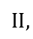
How Long Are People Typically Unemployed?
Long periods of unemployment are bad for workers, as their skills decay and they risk becoming discouraged and depressed.
During the Great Depression of the 1930s, some people were unemployed for years at a time.
Since World War
$$II,$$
the length of unemployment has been
relatively low, but that changed dramatically with the 2007–2009 recession.
The average length of unemployment more than doubled, from 4 months to 10 months.
After the 2020 Covid recession, the average length of unemployment exceeded 6 months.

Slide 15
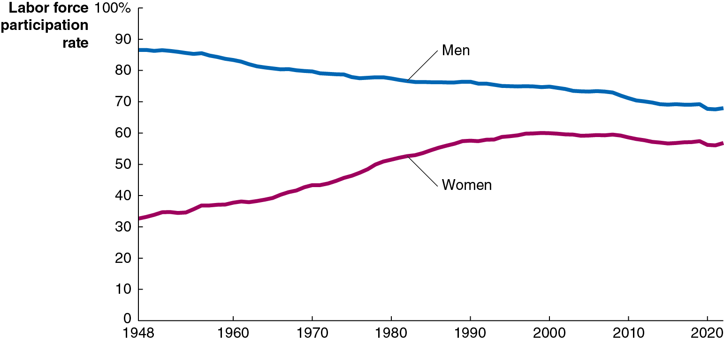
Figure 9.4 Trends in the Labor Force: Participation Rates of Adult Men and Women since 1948
The labor force participation rate of adult men has declined gradually since 1948…
… but it has increased significantly for adult women, making the overall rate higher today than it was then.
Recently, the rate for women has declined also.
Notes:
The horizontal axis represents year, and ranges from 1948 to 2020, in increments of 10 from 1960 to 2020. The vertical axis represents labor force participation rate and ranges from 0 to 90, in increments of 10. The line in red, for women, begins at 30.2 in 1948, rises to 66 in 2000, and falls to 60 in 2020. The line in blue, for men, begins at 88 in 1948 and falls consistently through 80 in 1980 to 70 in 2020. All values are estimated.

Slide 16
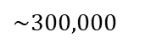
The Establishment Survey
In addition to the household survey, the B L S also uses the establishment survey, (a.k.a. the payroll survey).
This survey samples
$$\sim 300,000$$
establishments, or places of
employment, about their employees. Disadvantages include:
Self-employed people not surveyed (not on a company payroll)
Newly opened firms often omitted
Information on employment only, not unemployment
Numbers fluctuate depending on establishments included, often requiring large revisions
However, a big advantage is that the data are determined by real payrolls, not self-reporting like the household survey.

Slide 17
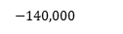
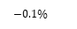
Table 9.1 Household and Establishment Survey Data for May and June 2023
Blank | Household Survey May | Household Survey June | Household Survey Change | Establishment Survey May | Establishment Survey June | Establishment Survey Change
Employed | 160,721,000 | 160,994,000 | 273,000 | 155,955,000 | 156,204,000 | 209,000
Unemployed | 6,097,000 | 5,957,000 | Negative 140,000 | Blank | Blank | Blank
Labor force | 166,818,000 | 166,951,000 | 133,00000 | Blank | Blank | Blank
Unemployment rate | 3.7% | 3.6% | negative minus 0.1 % | Blank | Blank | Blank
$$−140,000$$
$$−0.1\%$$
Source: U.S. Department of Labor, Bureau of Labor Statistics, The Employment Situation—February 2023, July 7, 2023.
Even if all surveys are truthfully and accurately answered, we do not expect the numbers to be identical between the two surveys:
Different groups are measured
All surveys have measurement errors
But we get a more complete picture by considering both surveys.

Slide 18
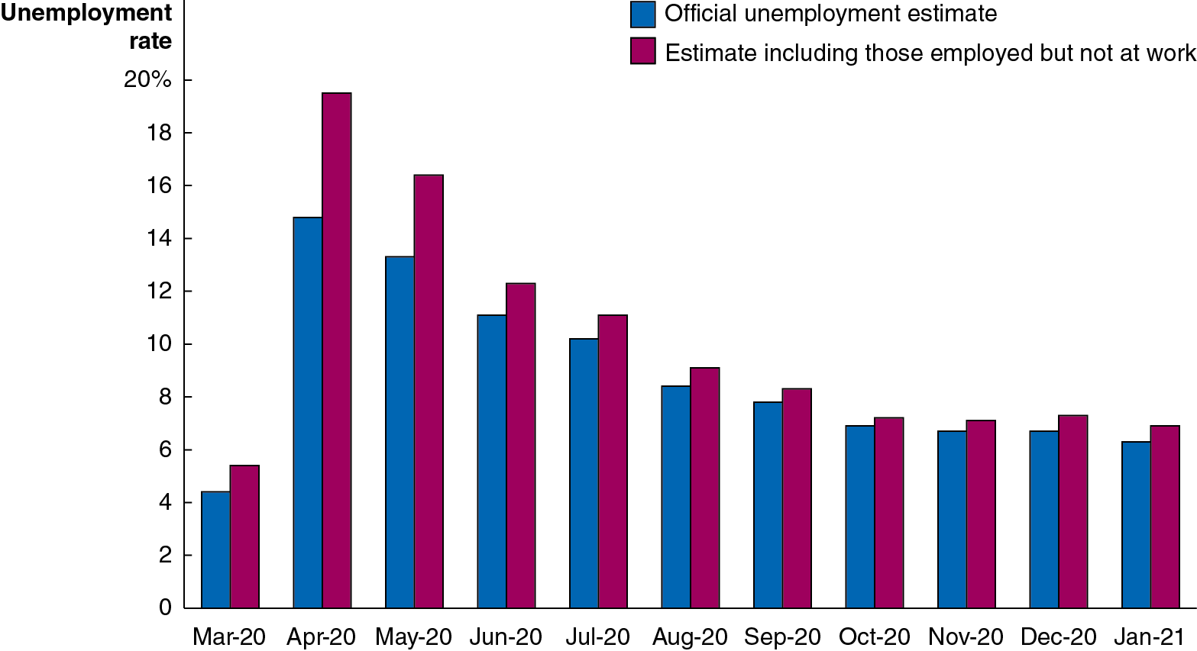
Apply the Concept: Problems with Labor Market Data during the Covid–19 Pandemic
During the pandemic, many people were not working because of business closures. Should we count those people as “unemployed” or “employed but absent from work”?
The B L S prepared both unemployment rates both ways, but decided to treat people officially as “employed but absent from work.”
Notes:
The vertical axis represents unemployment rate and ranges from 0 to 20%, in increments of 2%. The data is from the bar graph is tabulated as follows. March 2020. Official unemployment estimate, 4. Estimate including those employed but not at work, 5. April 2020. Official unemployment estimate, 15. Estimate including those employed but not at work, 19.5. May 2020. Official unemployment estimate, 13. Estimate including those employed but not at work, 16.5. June 2020. Official unemployment estimate, 11. Estimate including those employed but not at work, 12.5. July 2020. Official unemployment estimate, 10.5. Estimate including those employed but not at work, 11.5. August 2020. Official unemployment estimate, 9. Estimate including those employed but not at work, 10. September 2020. Official unemployment estimate, 8. Estimate including those employed but not at work, 8.5. October 2020. Official unemployment estimate, 7. Estimate including those employed but not at work, 7.5. November 2020. Official unemployment estimate, 7. Estimate including those employed but not at work, 7.5. December 2020. Official unemployment estimate, 7. Estimate including those employed but not at work, 8. January 2021. Official unemployment estimate, 6.5. Estimate including those employed but not at work, 7.5.

Slide 19
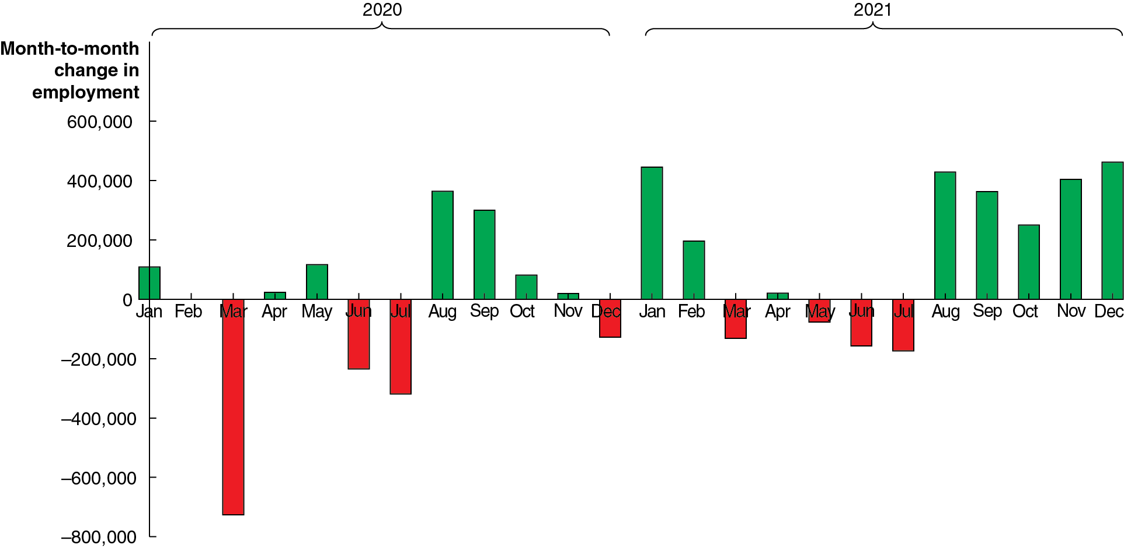
Apply the Concept: Problems Measuring Unemployment during the Covid-19 Pandemic
Another problem: the pandemic affected different sectors of the economy unequally, so seasonal adjustments became more difficult to perform. Later revisions for accuracy (shown in the figure above) ended up being larger than normal.
Notes:
The vertical axis for month to month change in employment ranges from negative 800,000 to 600,000, in increments of 100,000. The data from the bar graph is as follows. January 2021, 100,000. February 2021, 0. March 2020, negative 700,00. April 2020, 1000. May 2020, 10,000. June 2020, negative 300,00. July 2020, negative 350,00. August 2020, 350,000. September 2020, 300,000. October 2020, 50,000. November 2020, 10,000. December 2020, negative 150,00. January 2021, 450,000. February 2021, 200,000. March 2021, negative 100,00. April 2021, 10,000. May 2021, negative 20,000. June 2021, negative 200,00. July 2021, negative 210,00. August 2021, 400,000. September 2021, 350,000. October 2021, 300,000. November 2021, 400,000. December 2021, 450,000. All values are estimated.

Slide 20
Job Creation and Job Destruction over Time
Jobs are continually being created and destroyed in the U.S. economy.
In 2021, about 35.0 million jobs were created, while about 29.9 million jobs were destroyed.
This is a natural and normal process for the economy.
The B L S reports net changes in the number of people employed and unemployed; this does not fully represent how dynamic the U.S. job market really is.

Slide 21
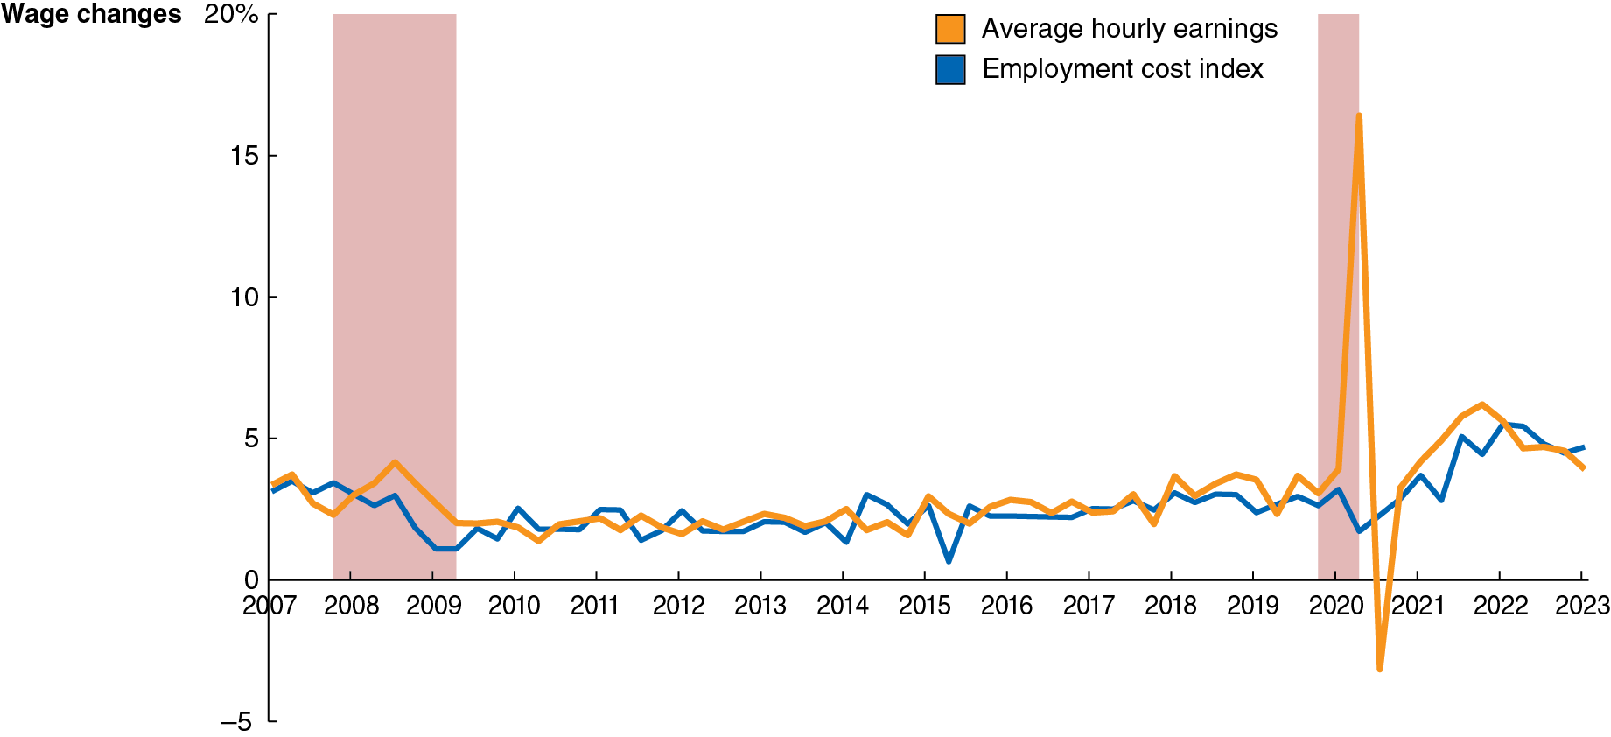
Figure 9.5 Measuring Changes in Wages Using Average Hourly Earnings and the Employment Cost Index
The B L S also publishes data on average hourly earnings (A H E), and the employment cost index (E C I), which includes benefits in addition to wages and salaries.
E C I data are usually more useful, because they include benefits and are adjusted for changes in the mix of occupations.
Notes:
The horizontal axis represents year, and ranges from 2007 to 2023, in increments of 1 year. The vertical axis represents wage changes, and ranges from negative 5 to 10, in increments of 1 percent. The economic recessions highlighted on the graph include the years as follows. 2007 to 2009 and 2020. The line in yellow for average hourly earnings starts at 4 in 2007, falls to 3 in early 2008, rises to 4.5 in mid 2008, falls to 2 in 2010, fluctuates constantly around 3 until 2019, peaks to 15 in late 2020, then plummets to negative 2 in late 2020, rises back to 4 in early 2021, and reaches 7 in late 2021 and ends at 4.5 in 2023. The line in blue for employment cost index starts at 4 in 2007, falls to 1 in 2009, fluctuates around 2until 2014, falls to 0.5 in late 2015, again fluctuates around 3 until 2020, and gradually peaks to 5.5 in 2022 and ends at 5 in 2023. All values are estimated.

Slide 22
9.2 Types of Unemployment
Identify the three types of unemployment.
The three types of unemployment are:
Frictional unemployment: Short-term unemployment that arises from the process of matching workers with jobs.
Structural unemployment: Unemployment that arises from a persistent mismatch between the skills or attributes of workers and the requirements of jobs.
Cyclical unemployment: Unemployment causes by a business cycle recession.
We will examine each type in turn over the coming slides.

Slide 23
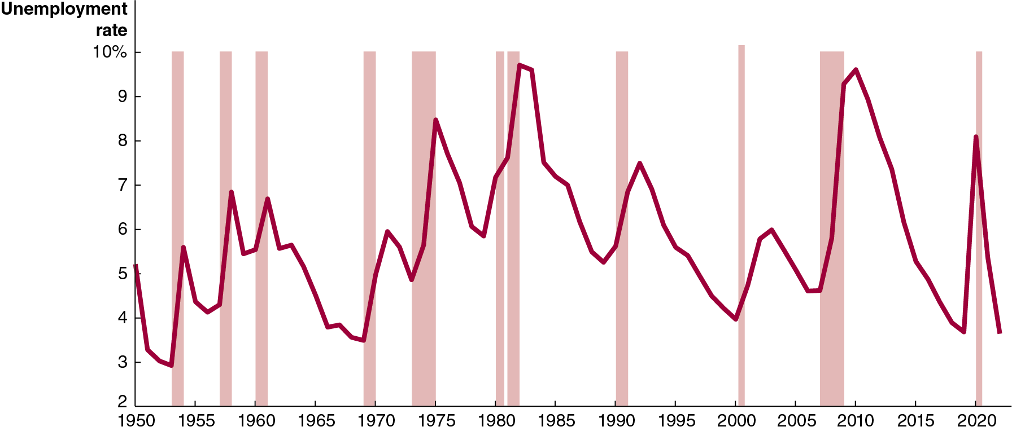
Figure 9.6 The Annual Unemployment Rate in the United States since 1948
Unemployment rates rise when the economy is faltering and fall when the economy is doing well. But they never fall to zero.
The types of unemployment can help us to understand why.
Notes:
NOTE: In the digital chapter, Figure 9.6 is an interactive real-time data graph, which means it automatically updates when new data becomes available.
The horizontal axis represents year, and ranges from 1950 to 2020, in increments of 5 years. The vertical axis represents unemployment rate, and ranges from 2 to 10, in increments of 1 percent. The economic recessions highlighted on the graph include the years as follows. 1953 to 1954, 1957 to 1958, 1960 to 1961, 1968 to 1970, 1973 to 1975, 1980 to 1981, 1982 to 1983, 1990 to 1991, 2001 to 2002, 2007 to 2009, and 2020. The line representing unemployment starts at 5.1 in 1950, rises during recessions and falls during expansions. The line falls to 3 in 1953, rises to 5.5 in 1954, falls to 4.5 in 1957, then rises to 6.7 in 1957 and falls to 3.5 in 1969, rises to 8 in 1975. In 1983, the rate rises to 9.8, falls to 5.5 in 1990, and gradually rises and falls at 4.7 in 2007, rises to 9.8 in 2009, and falls to 4 in 2019. The line then rises to 8 in 2020 and falls to 4 in 2022. All values are estimated.

Slide 24
Frictional Unemployment
Frictional unemployment: Short-term unemployment that arises from the process of matching workers with jobs.
Frictional unemployment occurs mostly because of job search: Entering or re-entering the labor force or being between jobs.
It also occurs because of seasonal unemployment: Some jobs fluctuate in availability due to seasonal demand, like ski instructor or farm work.
To control for this, the B L S releases raw and seasonally adjusted employment figures.
Some frictional unemployment actually increases economic efficiency by allowing for better job matches.

Slide 25
Structural Unemployment
Structural unemployment: Unemployment that arises from a persistent mismatch between the skills or attributes of workers and the requirements of jobs.
Structural unemployment is associated with longer unemployment spells.
Workers who are structurally unemployed may require retraining in order to obtain “modern” jobs.
Example: In the film and T V animation industry, jobs in hand-drawn 2-D illustration have fallen, and jobs in computer-assisted 3-D animation have risen. Even workers with the best hand-drawing skills may find themselves structurally unemployed.

Slide 26
Cyclical Unemployment and the Natural Rate of Unemployment
Cyclical unemployment: Unemployment caused by a business cycle recession.
In normal recoveries after a recession, unemployment due to cyclical factors will fall.
When all unemployment is due to frictional and structural factors, we say that the economy is at full employment. This means there will always be some unemployment in the economy.
Economists call this the natural rate of unemployment: The normal rate of unemployment, consisting of frictional unemployment and structural unemployment.
The general consensus of economists is that the U.S. natural rate of unemployment is somewhere between 4.0 percent and 5.0 percent.

Slide 27

Apply the Concept: Will Chatbots and Other Advances in Technology Permanently Increase Structural Unemployment?
Progress in robotics, automation, and A I are changing the way goods and services are produced and sold.
Similar disruption has happened for a long time; but some economists and policymakers believe these changes will be more disruptive to the labor force than previously.
The “technologically unemployed” are finding it harder to find comparable jobs than ever before.

Slide 28
9.3 Explaining Unemployment
Explain what factors determine the unemployment rate.
Governments often attempt to directly influence unemployment.
Example: The federal government’s Trade Adjustment Assistance program offers training to workers whose firms laid them off as a result of competition from foreign firms. This would reduce structural unemployment.
Other policies try to reduce frictional unemployment, for example, by subsidizing new hires.
However, some other government policies probably increase unemployment, such as:
Unemployment insurance
Minimum wage laws

Slide 29
Unemployment Insurance
Suppose you have just lost your job. You want to find another and have two main options:
Take a new low-paying job immediately or
Search for a better job
If unemployment insurance payments are available to you, you will probably be more likely to choose the second option.
In the United States, unemployment insurance payments are typically not very generous, compared with other high-income countries; and there are relatively short time limits.
Unemployment benefits are more generous, and unemployment rates higher, in Western European countries.
Do you think these facts are related?

Slide 30
Minimum Wage Laws
Federal minimum wage law was introduced in 1938: $0.25/hour.
In mid-2021, the federal minimum wage was $7.25/hour.
Many states and cities have higher minimum wages.
Example: In 2023, California’s minimum wage was $15.50/hour, and San Francisco’s minimum wage was $18.07/hour.
Studies suggest a 10 percent increase in the minimum wage reduces teenage employment by about 2 percent.
Overall effect on unemployment rate is probably small at current levels, since relatively few people earn minimum wage.

Slide 31
Labor Unions
Labor unions are organizations of workers that bargain with employers for higher wages and better working conditions.
Unions are probably not a significant cause of unemployment in the United States. While they raise the wage, only about 6 percent of private sector workers are unionized, limiting the effect that unions have on the wider economy.

Slide 32
Efficiency Wages
Efficiency wage: An above-market wage that a firm pays to increase workers’ productivity.
Firms want to get the best performance they can out of their workers.
Sometimes monitoring workers is difficult or costly. An alternative is to pay them a relatively high wage, making them motivated to perform well in order to keep their job.
These above-market wages are probably another reason why unemployment exists even when cyclical unemployment is zero: more people want these high-paying jobs than there are jobs available.

Slide 33
9.4 Measuring Inflation
Define the price level and the inflation rate and understand how they are computed.
In Chapter 18, we introduced the idea of the price level: A measure of the average prices of goods and services in the economy.
We refer to the percentage increase in the price level from one year to the next as the inflation rate.
In the last chapter, we used the G D P deflator to measure changes in the price level. By measuring changes in the prices of different baskets of goods, we would come up with different measures.
Two commonly used measures are:
The consumer price index (C P I)
The producer price index (P P I)

Slide 34
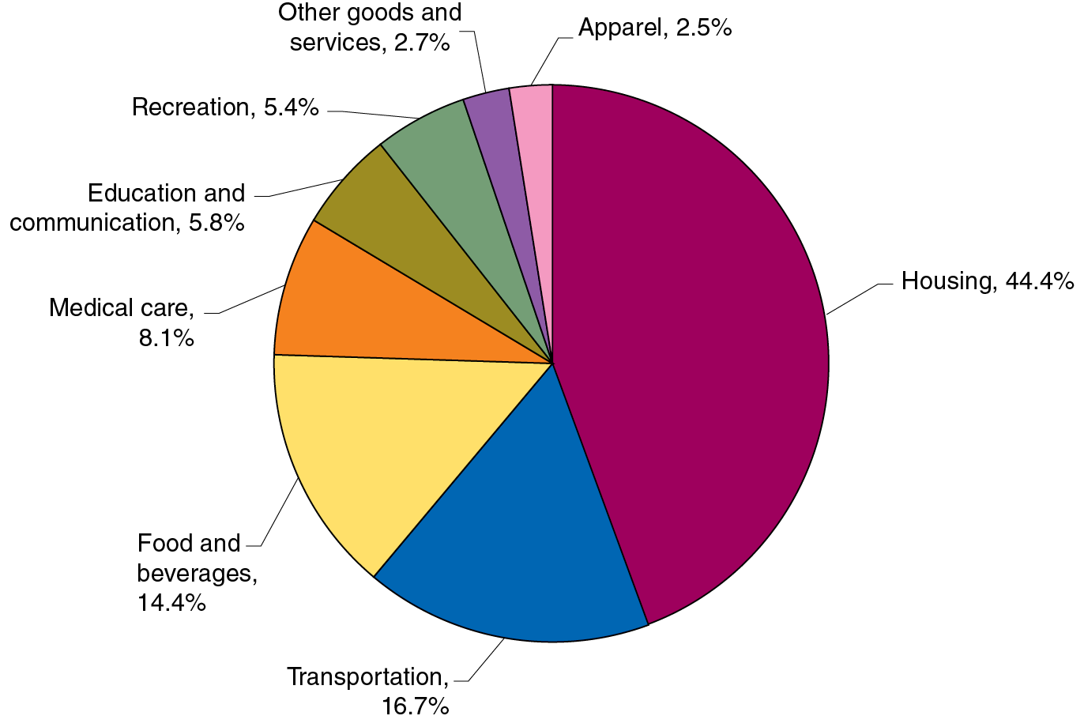
Figure 9.7 The C P I Market Basket, December 2020
The consumer price index (C P I) is a measure of the average of the prices a typical urban family of four pays for the goods and services they purchase.
The chart shows the composition of the basket of goods used to create the C P I. This basket of goods derives from a survey of 14,000 households by the B L S.
Notes:
The data from the pie chart is as follows.
Housing, 44.4%
Transportation, 16.7%
Food and beverages, 14.4%
Medical care, 8.1%
Education and communication, 5.8%
Recreation 5.4%
Other goods and services, 2.7%
Apparel, 2.5%

Slide 35
Calculating the C P I
To calculate the C P I in a given year, we need:
A basket of goods
The cost to purchase the basket of goods in a base year
The prices in the current year
The C P I in the current year is the cost to purchase the basket of goods this year, divided by the cost in the base year. By convention, we multiply this by 100, so that the C P I in the base year is 100.

Slide 36
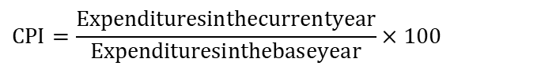
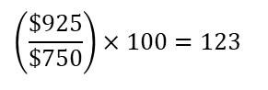
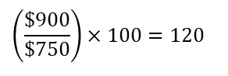
A Simple C P I Calculation (1 of 2)
Product | Base Year (2015) Quantity | Base Year (2015) Price | Base Year (2015) Expenditures | 2024 Price | 2024 Expenditures (on base-year quantities) | 2025 Price | 2025 Expenditures (on base-year quantities)
Eye examinations | 1 | $50 | $50 | $100 | $100 | $85 | $85
Pizzas | 20 | 10 | 200 | 15 | 300 | 14 | 280
Books | 20 | 25 | 500 | 25 | 500 | 28 | 560
Total | Blank | Blank | $750 | Blank | $900 | Blank | $925
The table above gives the information we need to create the C P I in 2024 and 2025, using the basket of goods from 2015.
Formula | Applied to 2024 | Applied to 2025
C P I equals expenditures in the current year over expenditures in the base year all times 100. | 900 dollars over 750 dollars multiplied by 100 equals 120. | left parenthesis start fraction $925 over $750 end fraction right parenthesis times 100 = 123
$$CPI=\frac{Expendituresinthecurrentyear}{Expendituresinthebaseyear}×100$$
$$\left(\frac{\$900}{\$750}\right)×100=120$$
$$\left(\frac{\$925}{\$750}\right)×100=123$$

Slide 37
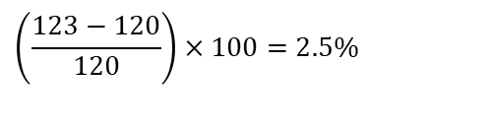
A Simple C P I Calculation (2 of 2)
Based on these data, the inflation rate from 2024 to 2025 is the percentage change in the C P I:
$$\left(\frac{123−120}{120}\right)×100=2.5\%$$
Since the C P I measures consumer prices, it is called the cost- of-living index. C P I inflation is sometimes used to generate “fair” increases in wages for workers and government benefits.

Slide 38
Is the C P I an Accurate Measure of Inflation?
Some potential problems with the C P I include:
Substitution bias: Consumers may change their purchasing habits away from goods that have increased in price.
Increase in quality bias: Difficult to separate improvement in quality from increase in price, say in cars or computers.
New product bias: The basket of goods used to change only every 10 years. (Now it updates every 2 years.) There is a delay to including new goods like cell phones.
Outlet bias: C P I used to only survey prices at traditional retail outlets. Now, it tries to minimize this bias by surveying people about where they actually buy products, including discount stores and online sellers.
Economists believe the C P I overstates true inflation by 0.5 to 1 percentage point (an improvement over previous methods).

Slide 39
Producer Price Index
The producer price index (P P I) is an average of the prices received by producers of goods and services at all stages of the production process.
It is conceptually similar to the C P I, in that it uses a basket of goods, but the goods are those used by producers.
Includes raw materials like coal and crude petroleum and intermediate goods like flour, yarn, steel, and lumber.
The P P I can give early warning of future movements in consumer prices.
Can you suggest why this is true?

Slide 40
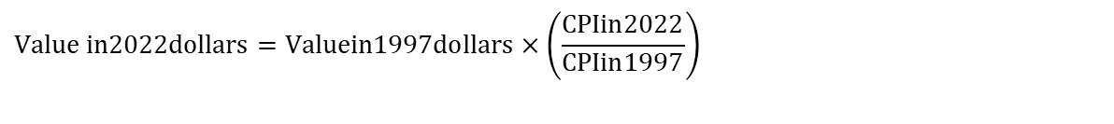
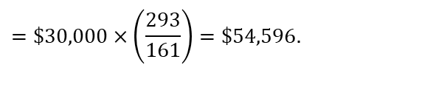
9.5 Using Price Indexes to Adjust for the Effects of Inflation
Use price indexes to adjust for the effects of inflation.
Suppose your mother received a salary of $30,000 in 1997. This would have bought much more than a salary of $30,000 in 2022.
We can use the C P I to estimate the purchasing power of that $30,000 in 2022 dollars:
$$Value in2022dollars=Valuein1997dollars×\left(\frac{CPIin2022}{CPIin1997}\right)$$
$$=\$30,000×\left(\frac{293}{161}\right)=\$54,596.$$
So, $30,000 in 1997 would have bought about as much as $54,596 in 2022.

Slide 41
Nominal and Real Variables
The current standard base “year” for the C P I is an average of 1982–1984 prices.
Values like wages in current-year dollars are called nominal variables. When we adjust them for inflation, by dividing by the current year’s price index and multiplying by 100, we convert them to real variables.
This is useful for comparing variables across time.

Slide 42
9.6 Nominal Interest Rates versus Real Interest Rates
Distinguish between the nominal interest rate and the real interest rate.
When you lend money to someone, they typically agree to pay you back with interest. If the interest rate is 4 percent, for example, then a $1,000 loan paid back in a year will be paid back with $1,040.
4 percent is the nominal interest rate: The stated interest rate on a loan.
We can adjust for inflation by calculating the real interest rate, equal to the nominal interest rate minus the inflation rate.
This is an approximation, but it is quite accurate for low interest and inflation rates.
If prices rise by 2 percent from this year to next, then your real interest rate on the loan is only 2 percent. This more accurately reflects the cost of borrowing and lending money.

Slide 43
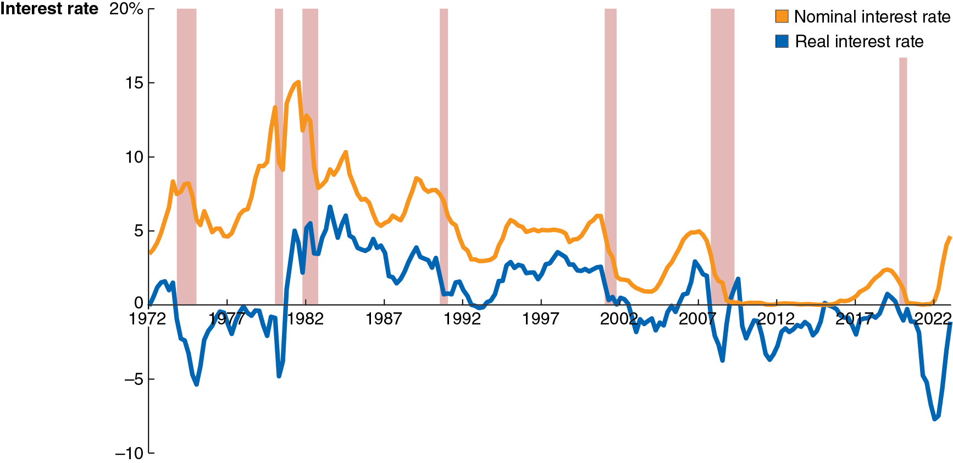
Figure 9.8 Nominal and Real Interest Rates, 1972–2023
The chart shows the interest rate on three-month treasury bills, a good measure of the nominal interest rate.
The real interest rate adjusts them for changes in the C P I.
In 2009 and again in 2015, the real interest rate was above the nominal interest rate. The change in the C P I was negative then, indicating a rare deflation, or decline in the price level.
Notes:
The horizontal axis represents year, and ranges from 1972 to 2022, in increments of 10 years. The vertical axis represents interest rate and ranges from negative 10 to 20, in increments of 5 percent.
The line in blue for real interest rate starts from 0 in 1972, falls to negative 6 in 1975. The line rises to negative 0.5 in 1977, and fluctuates below 0 till 1980 and rises to 5 in 1982, fluctuates and gradually falls to 0 in 1992, then rises to 3 in 1998 and falls to negative 1 in 2003. The line then rises to 3 in 2007 and immediately falls to negative 4 in 2008, and then rises to 2 in 2011. The line fluctuates around negative 1 until 2014, then reaches 0 in 2015, falls to negative 1 in 2017. The line then reaches 0.5 in 2020, falls to negative 7 in 2022 and ends at negative 1 in 2023. The line in yellow for nominal interest rate rises from 3.8 in 1972, to 8 in 1975, falls to 5 in 1977, and then rises to 15 in 1980, then gradually rises and falls in an irregular pattern, before falling to 0 in 2010, and runs along the horizontal axis until 2015, and beginning to rise again in 2019 to 2. The line then falls to 0 in 2020 and then ends at 5 in 2023. The area between years 1973 to 1975, 1980 to 1981, 1982 to 1983, 1990 to 1991, 2001 to 2002, 2007 to 2009, and year 2020 are shaded and indicate economic recession. All values are estimated.

Slide 44
9.7 Does Inflation Impose Costs on the Economy?
Discuss the problems that inflation causes.
Sometimes inflation seems unimportant.
If all prices doubled overnight, it seems like nothing much would change: the prices of goods and services would have doubled, but so would your wage.
So, you could afford exactly as much as before.
But not all prices and wages rise at the same rate.
So, some people will see their real wage increase due to inflation, while others will see it decrease.
Particularly for people on fixed incomes (e.g., retirees), inflation can seem unfair because the purchasing power of their income falls.

Slide 45
The Problem with Anticipated Inflation
Even if inflation is anticipated, it still causes problems:
Because some prices and incomes will remain fixed, some redistribution of income will occur.
People and firms have increased real costs of holding cash. (The cash that they hold will decrease in value.)
Firms have menu costs: The cost to firms of changing prices. Frequently changing prices are inconvenient for firms (and consumers too!) to deal with.
Investors are taxed on nominal returns, rather than real returns; so, this can increase the tax due.

Slide 46
The Problem with Unanticipated Inflation
When people cannot predict the rate of inflation, they find it hard to make good borrowing and lending decisions.
For example, in 1980 banks were charging 18 percent or more on home loans because the rate of inflation was very high. People who bought homes were locked into high rates even when inflation subsided.
On the other hand, if banks lend money at a low rate and then high inflation takes place, the real interest rate they receive may be zero or negative; therefore, the risk of inflation makes banks wary of lending.
Unpredictable inflation makes borrowing and lending risky.

Slide 47
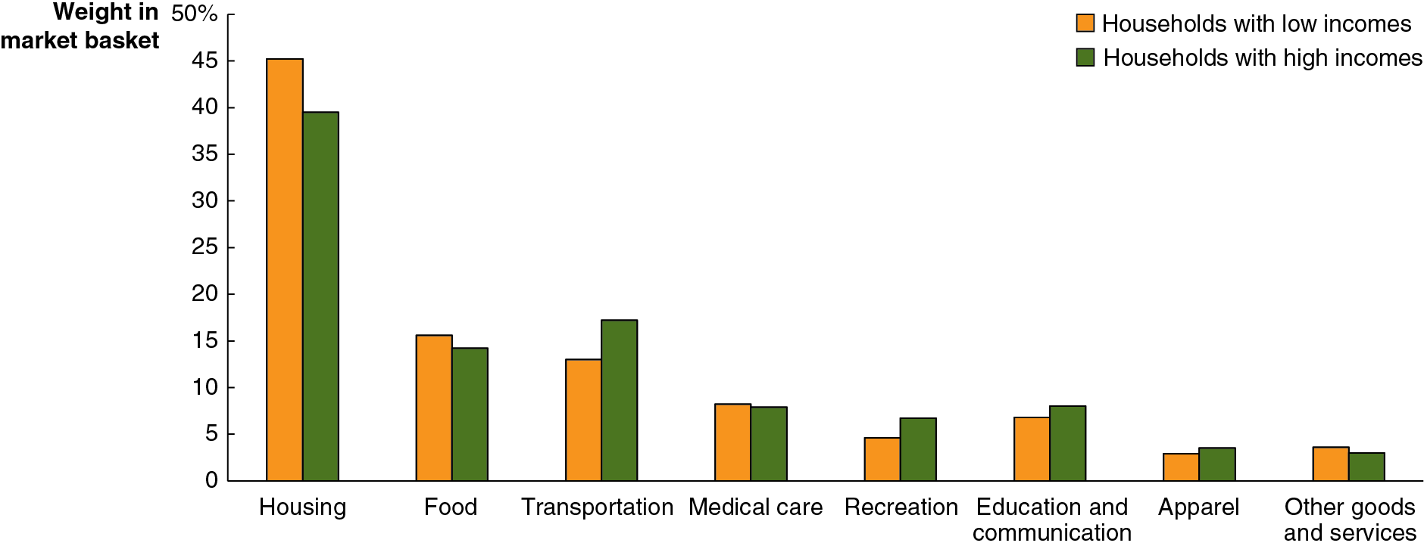
Apply the Concept: Does Inflation Have a Larger Effect on People with Lower Incomes than on People with Higher Incomes? (1 of 3)
Increases in unemployment during recessions affect people with lower incomes; employers are more likely to lay off those workers.
What about inflation? Does that affect people with lower incomes more than those with higher incomes?
The graph above illustrates the possibility of this differential effect: different types of households spend differently.
Notes:
The vertical axis represents weight in market basket and ranges from 0 to 50%, in increments of 5%. The data is from the bar graph is tabulated as follows. • Housing. Households with low incomes, 45. Households with high incomes, 40. • Food. Households with low incomes, 16. Households with high incomes, 15. • Transportation. Households with low incomes, 14. Households with high incomes, 18. • Medical care. Households with low incomes, 9.5. Households with high incomes, 9. • Recreation. Households with low incomes, 5. Households with high incomes, 7. • Education and communication. Households with low incomes, 8. Households with high incomes, 10. • Apparel. Households with low incomes, 7. Households with high incomes, 8. • Other goods and services. Households with low incomes, 8. Households with high incomes, 6. All values are estimated.

Slide 48
Apply the Concept: Does Inflation Have a Larger Effect on People with Lower Incomes than on People with Higher Incomes? (2 of 3)
blank | Average Annual Rate of Increase in C P I | Average Annual Rate of Increase in C P I for Lowest-Income Quartile | Average Annual Rate of Increase in C P I for Highest-Income Quartile
Entire period | 2.3% | 2.5% | 2.2%
March 2021– December 2021 | 5.4% | 5.1% | 5.3%
The high inflation during 2021 affected people with higher incomes more than those with lower incomes.
Why? Primarily because the prices of new and used cars increased so much in 2021, and those constitute a larger proportion of spending for higher-income households than lower-income ones.

Slide 49
Apply the Concept: Does Inflation Have a Larger Effect on People with Lower Incomes than on People with Higher Incomes? (3 of 3)
blank | Overall Wage Growth | Wage Growth in Lowest Quartile | Wage Growth in Highest Quartile | Price Inflation as Measured by the C P I
January 2005– December 2021 | 3.1% | 3.3% | 3.1% | 2.3%
March 2020– April 2023 | 4.4% | 5.5% | 3.5% | 4.9%
For most people, the most important aspect of inflation is whether prices are increasing more quickly or more slowly than their wages—that is, the effect on their real wage.
During the period after the beginning of the Covid-19 pandemic, wage growth for workers with the lowest incomes was actually higher than for higher-income workers, and their wage growth did outpace inflation.

Slide 50

Copyright
This work is protected by United States copyright laws and is provided solely for the use of instructors in teaching their courses and assessing student learning. Dissemination or sale of any part of this work (including on the World Wide Web) will destroy the integrity of the work and is not permitted. The work and materials from it should never be made available to students except by instructors using the accompanying text in their classes. All recipients of this work are expected to abide by these restrictions and to honor the intended pedagogical purposes and the needs of other instructors who rely on these materials.

